Slide 1
Stolen Vehicle Recovery System
Name: NIYOKURI Berenice
ID: 27249
AUCA – IT Faculty Date: 9th December, 2025

Slide 2
Problem Identification
Vehicle theft causes financial and operational losses: Stolen vehicles lead to direct financial losses for owners and insurance companies. Law enforcement spends additional resources tracking and recovering stolen vehicles. Delays in response can increase the risk of theft escalation or damage, affecting both public safety and operational efficiency.
Lack of real-time monitoring and rule enforcement: Traditional systems often rely on manual reporting, which causes delays. Alerts may go unnoticed or unchecked, especially outside regular working hours. Without automated enforcement of business rules (e.g., duplicate alert prevention or restricted insert times), data inconsistencies and misuse can occur.
Police, administrators, and city traffic department need efficient, transparent alert handling: Police require prioritized alerts to respond quickly to high-risk cases. Administrators need audit logs and reports to ensure compliance with policies and identify operational gaps. The city traffic department benefits from aggregated data and trends for policy planning and resource allocation. A centralized, automated system ensures all stakeholders can access accurate, up-to-date information in a transparent manner.

Slide 3
solution
Our system centralizes all vehicle, alert, and user data into a single database. Alerts are automatically checked for duplicates or restricted times, and all actions are logged in real time. Business Intelligence dashboards allow stakeholders to see trends, compliance, and performance metrics. Finally, PL/SQL procedures ensure updates are secure and controlled:
Centralized database for vehicles, alerts, and users.
Automated alert handling with rule enforcement.
Real-time audit logging for transparency.
BI dashboards for decision-making.
Secure, controlled updates via PL/SQL procedures.

Slide 4
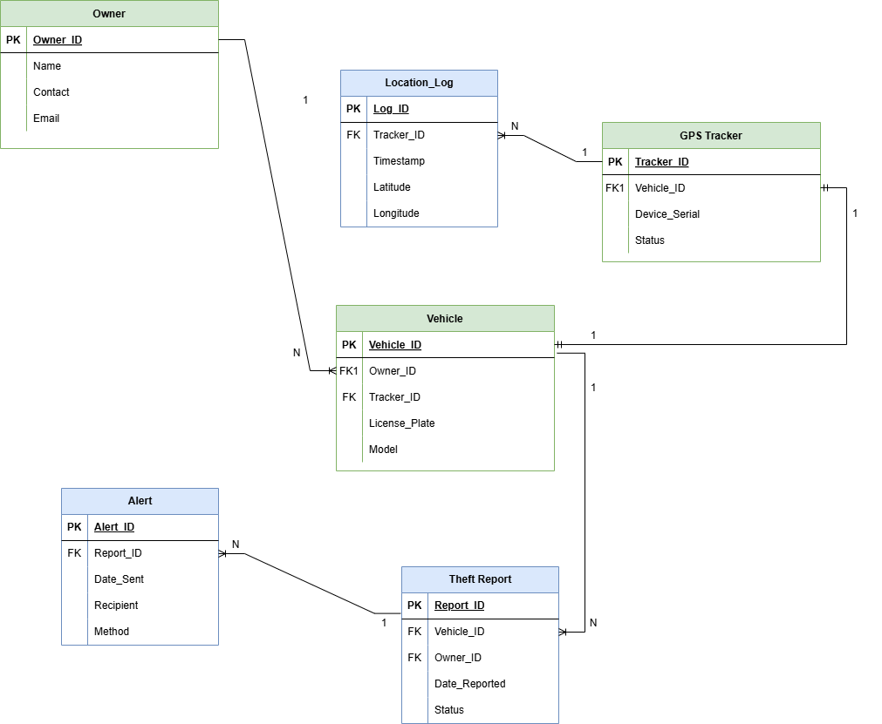
Database er
Key Entities:
Owner
Vehicle
Alert
Theft Report
Location_log
GPS Tracker
ER Diagram assumes:
1–many Vehicles → Alerts
Alerts are only sent after theft confirmation.
One owner can register multiple vehicles.

Slide 5
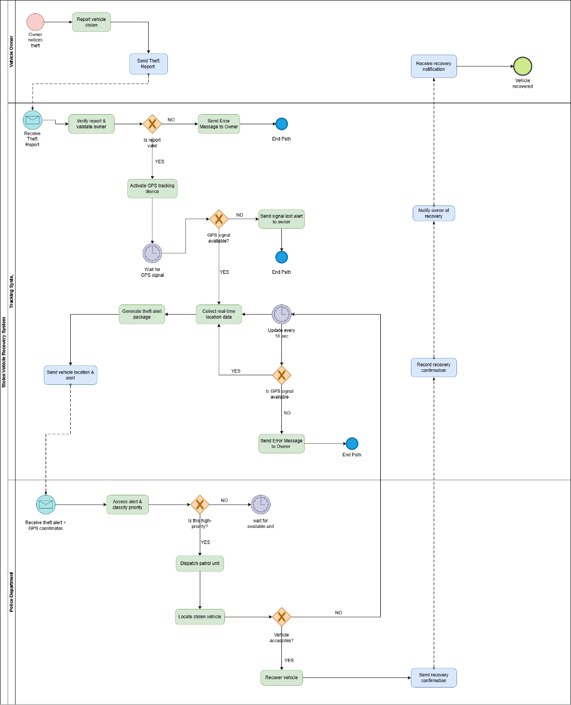
Business process
Swimlane Summary
Vehicle Owner: Report stolen vehicle → Submit theft alert → Receive recovery notification
Tracking System: Validate report → Activate GPS → Track location → Send alert to police → Record recovery
Police Department: Receive alert → Prioritize case → Dispatch unit → Recover vehicle → Confirm recovery
Flow: Theft report → Verification → GPS activation → Location tracking → Police alert → Recovery → Owner notification

Slide 6
Technical
We used Oracle XE 21c for the database backend. PL/SQL procedures handle updates securely, while triggers automate auditing and enforce business rules. For example, duplicate alerts or inserts during weekdays/holidays are automatically prevented:
Oracle Database XE 21c
PL/SQL procedures for secure updates
Triggers for automatic auditing and DML validation
Automated rule enforcement (weekdays, holidays, duplicates)

Slide 7
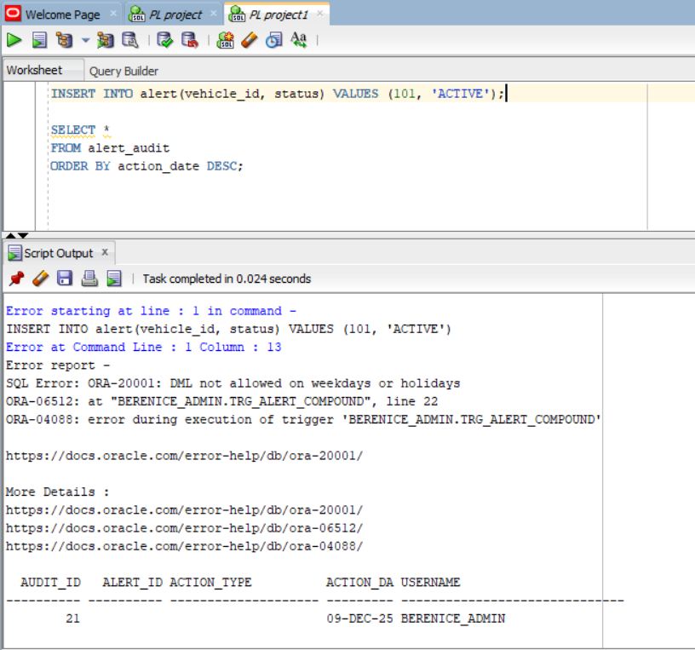
Advanced Features
Compound Trigger: Logs both allowed and denied DML attempts
Security Rules:
No weekday alerts
Duplicate-alert prevention
Holiday restrictions
Autonomous Transactions: Ensures audit logging even during failures
Error Logging: Custom log_error procedure
Consistent Data Integrity: Controlled changes through PL/SQL

Slide 8
BI
Dashboards:
Executive Summary Dashboard
Audit & Compliance Dashboard
Performance Dashboard
KPIs:
Alerts per day/week
Denied vs allowed alerts
Avg. police response time
% of resolved alerts
Peak alert hours
Reports:
Daily alert summary
Weekly trends
Monthly executive insights

Slide 9
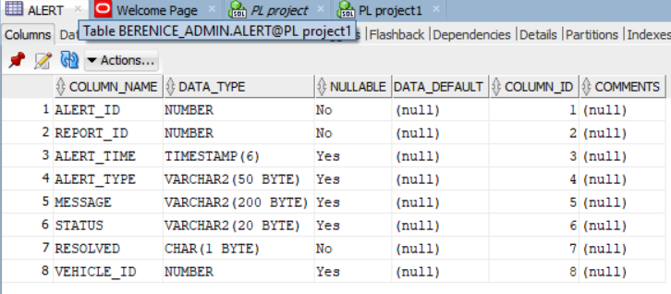
Results & Testing
Successful creation of all tables, triggers, and procedures
Audit log captures every allowed/denied action
Duplicate-alert rule tested and validated
Weekday/holiday restrictions working correctly
Sample screenshots:
Alert table
Audit log
Trigger behavior
Procedure execution

Slide 10
conclusion
In conclusion, the system improves alert management, enforces rules automatically, and provides stakeholders with actionable insights through BI dashboards. Lessons learned include the critical role of auditing and secure PL/SQL procedures. Future enhancements could include advanced analytics like geolocation and predictive alerts:
Achievements: Centralized alert system, automated enforcement, BI insights
Lessons: Importance of auditing, secure updates, real-time monitoring
Next Steps / Q&A: Expand dashboards, add geolocation analytics

